Slide 1
Aspect-Based Opinion Mining from Product Reviews Using Conditional Random Fields
Speaker: Jim-an tsai
advisor: professor jia-lin koh
Author:Amani K. Samha, Yuefeng Li, Jinglan Zhang
Date: 2018/3/6
Source: AusDM,15

Slide 2
Outline
Introduction
Method
Experiment
Conclusion

Slide 3
Motivation
Product Reviews

Slide 4
Purpose
For Time Saving，We need Aspect-Based Opinion Mining!!
GOAL : How to improve ABOM??

Slide 5
Outline
Introduction
Method
Experiment
Conclusion

Slide 6
Framework

Slide 7
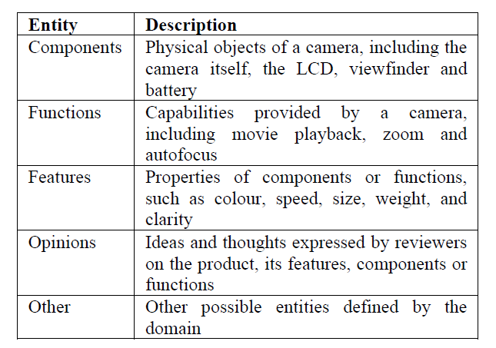
Dataset tagging process

Slide 8
Dataset tagging process

Slide 9
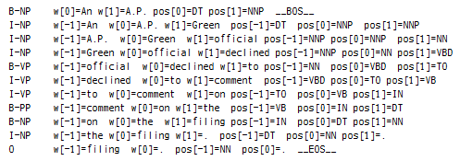
CRF model
Input: (T|W, POS, Chunking).
Chunking
T|W
POS
Notes:
https://stackoverflow.com/questions/1833252/java-stanford-nlp-part-of-speech-labels
https://stackoverflow.com/questions/15059878/opennlp-chunker-and-postag-results
http://opennlp.apache.org/docs/1.8.3/manual/opennlp.html#tools.chunker.training
http://www.chokkan.org/software/crfsuite/manual.html
http://www.chokkan.org/software/crfsuite/tutorial.html
https://github.com/scrapinghub/python-crfsuite/blob/master/examples/CoNLL%202002.ipynb
https://stackoverflow.com/questions/1833252/java-stanford-nlp-part-of-speech-labels
http://it.uu01.me/p/ovqeqv.html

Slide 10
Chunking

Slide 11
Features

Slide 12
Features
Example:

Slide 13
Outline
Introduction
Method
Experiment
Conclusion

Slide 14
Model label performance

Slide 15
performance

Slide 16
Outline
Introduction
Method
Experiment
Conclusion

Slide 17
Conclusion
We propose a CRF-based method to extract all possible aspects and corresponding opinions in reviews and integrate basic linguistic features with statistical features and combined features.
We were able to achieve high performance when applying CRFs to opinion mining by the selected feature functions.

